Slide 1


Web Application Workshop
Computer Science and Informatics
School of Engineering
Lsbu_csi ; lsbu_csi_community

Slide 2

Workshop Plan
Session 1:
Introduction to Figma
Wireframe design of the application.
Get Git and GitHub ready
Introduction to Web Development
Session 2- 4
Develop the website ( HTML CSS)
Use Git and GitHub.
Database creation (MySQL)
Session 5
Deploy the Website
Share on Linkedin Profile

Slide 3
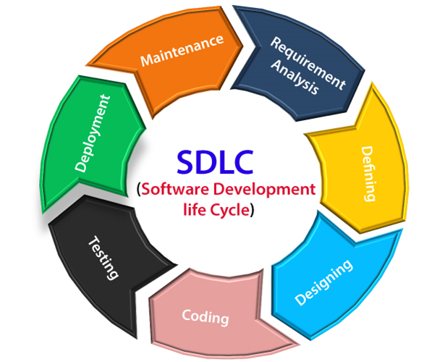
What is design?
Plan or blueprint of a Software system.
Purpose of Design:
Clarification of Requirements
Plan and organise software components
Feedback and communication
Areas including, UML design, UI design

Slide 4
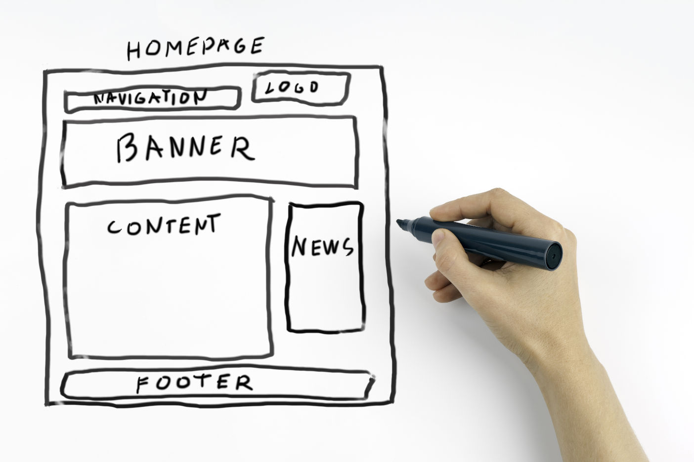
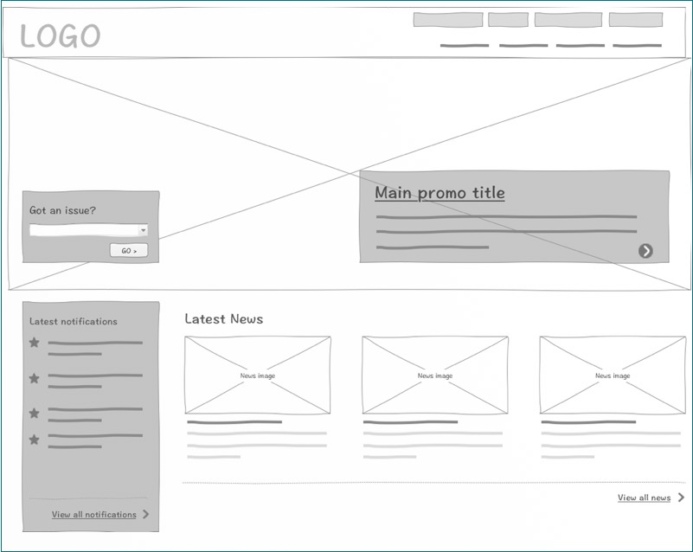
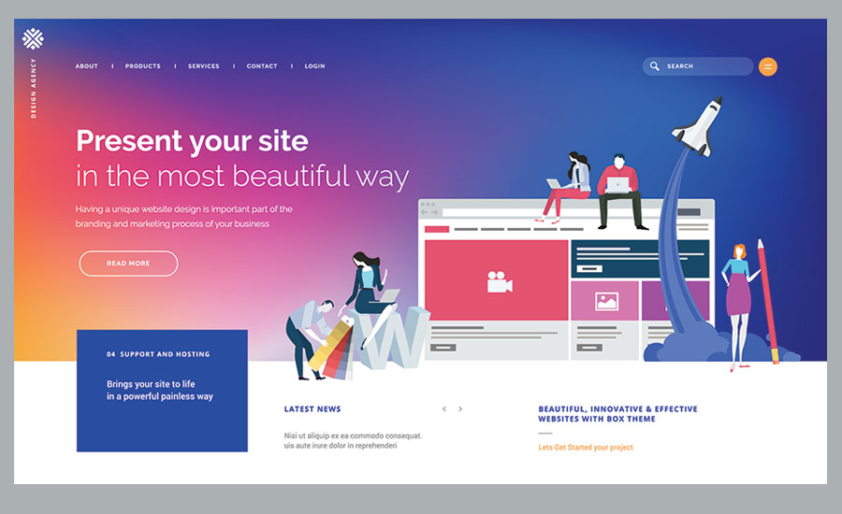
Low Fidelity Design
High Fidelity Design
Sketch:
Wireframe: High-level sketch, no detailed visual elements
Mockup: Static visual
Tools:
Pen and Paper
Apps: Procreate, SketchBook, any applications allows drawing
Tools:
Balsamiq, Figma, Sketch, Mockflow
Tools:
Balsamiq, Figma, Adobe XD, Sketch, Adobe Photoshop, Zeplin
Notes:
Wireframe: high-level sketch of the page or functionality. Doesn’t contain detailed visual elements.
Mockup: Static visual of the product and features.

Slide 5
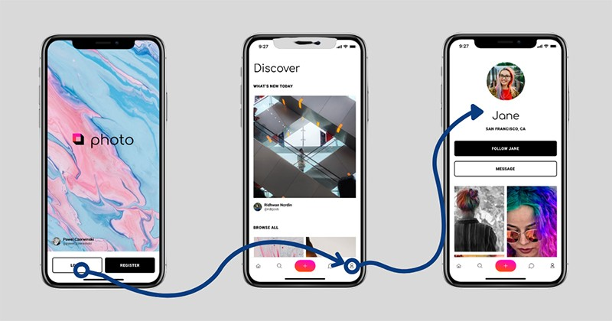
Prototype
A dynamic model of the product.
More interactive with details.
Wireframe/Mockup link of the Quiz App:
https://www.figma.com/file/tGlAY3WfqdQTTY9TAqfYqC/QuizApp?type=design&node-id=0%3A1&mode=design&t=3H4cGwGWay1mL9I8-1

Slide 6
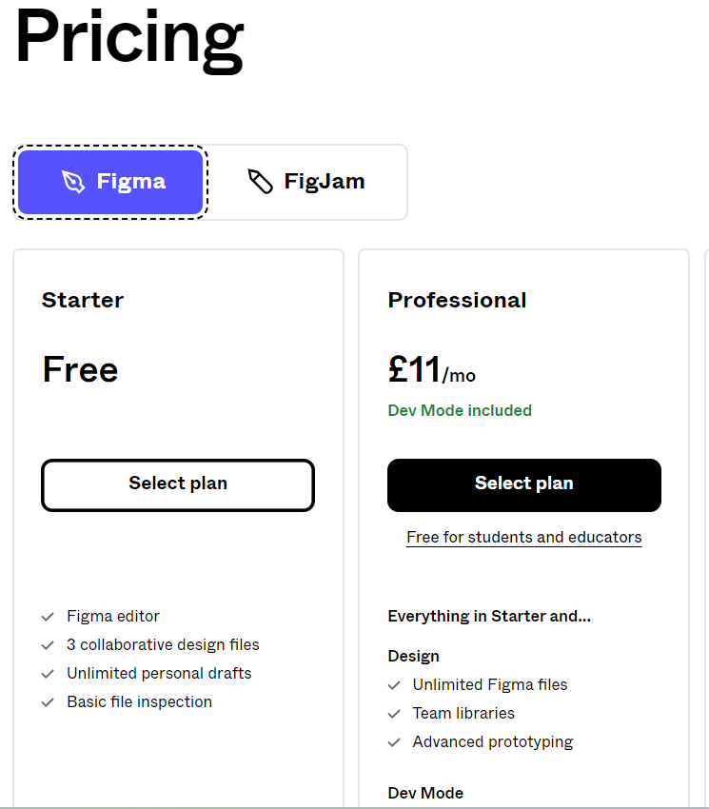
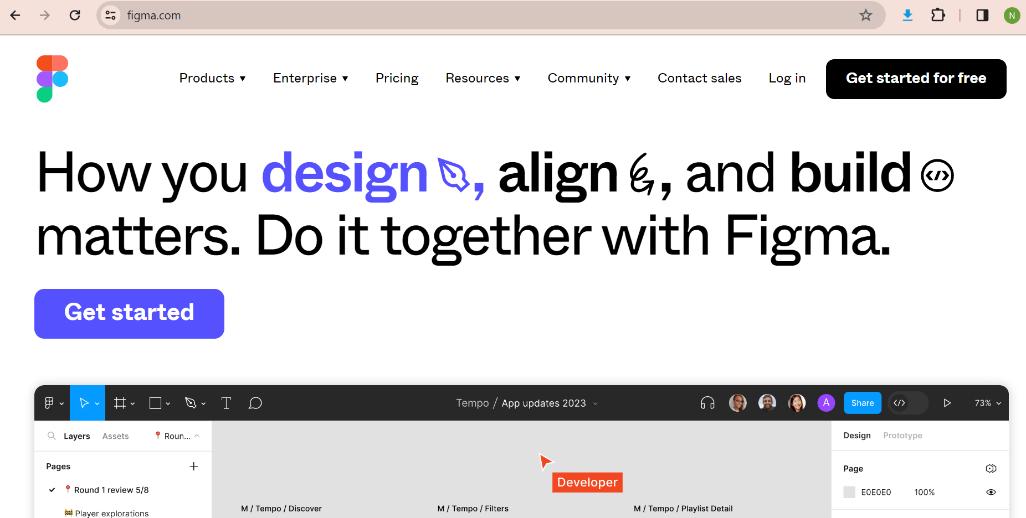
Introduction to Figma
Access from any browser: https://www.figma.com/

Slide 7
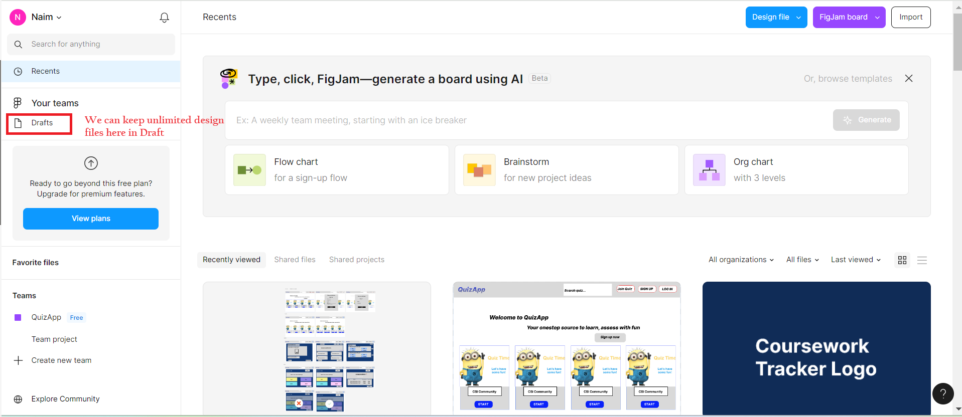
Introduction to Figma
Create a new Design File
Once we login to figma.com, we see the following screen.

Slide 8
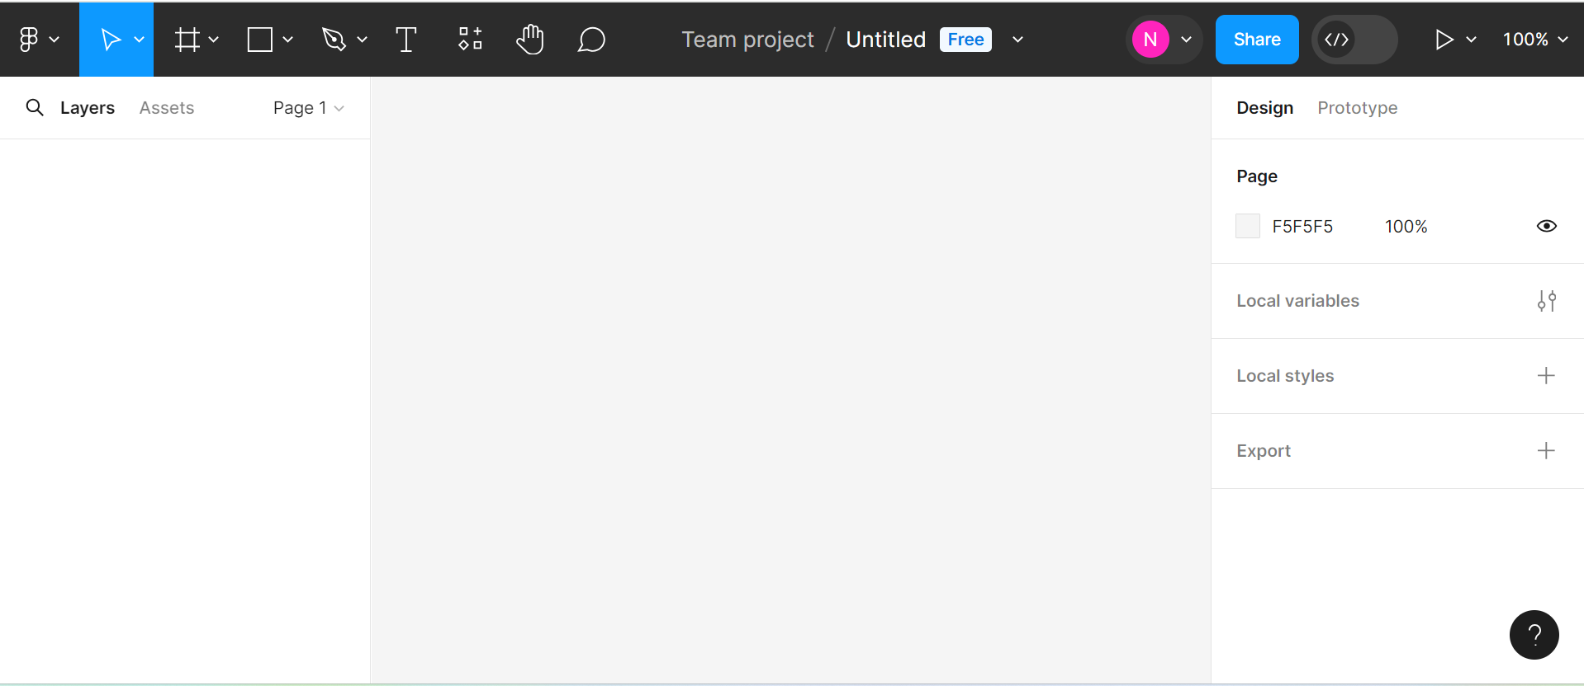
Figma Design Interface
Menu
Tools
Options
Canvas
Layers
Properties

Slide 9
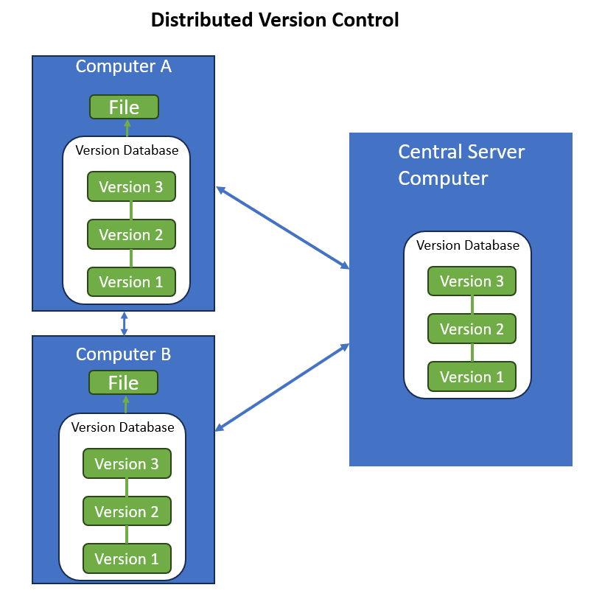
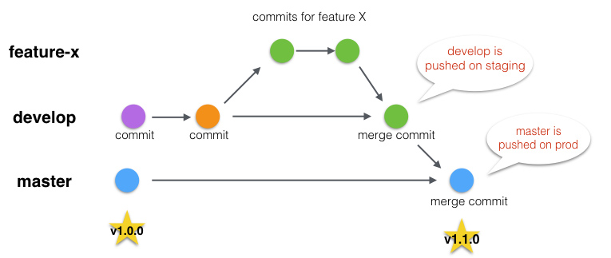
Introduction to Git
Open-source version control system
Fast and Distributed
Easy to learn and team collaboration

Slide 10
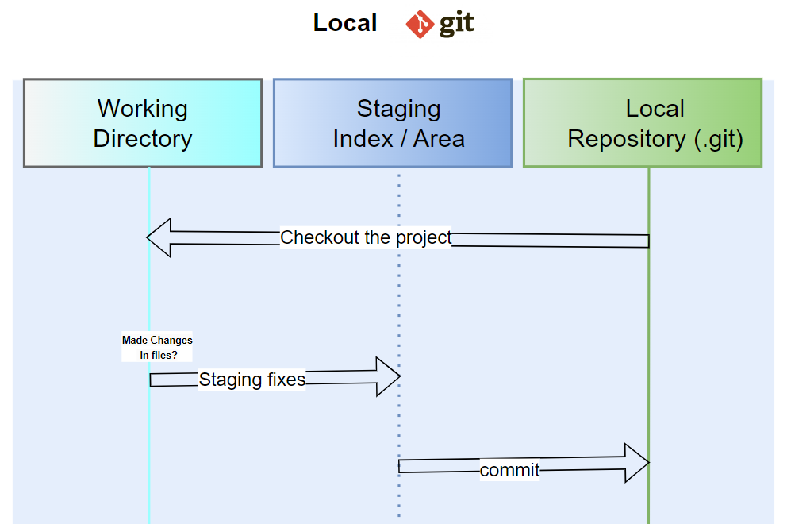
Git has three states:
Modified: File has changed but not committed to the database
Staged: Marked a modified file in its current version. Ready to go in the next commit snapshot.
Committed: Data is safely stored in the local database.
Git project sections:
Working Directory: Local directory of our project
Staging area/index: Stores information on what will go into the next commit.
Git directory: '.git' directory where Git stores all the information. If we delete this folder, git will lose all the tracking.

Slide 11
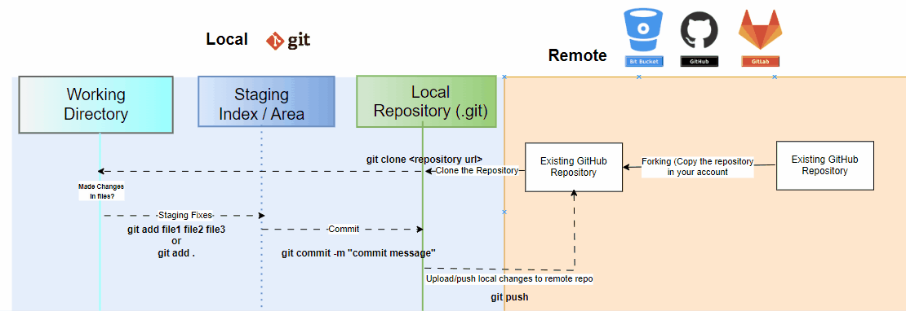
Git Flow of the Workshop
GitHub Repository: https://github.com/seenaimul/csi-quizapp

Slide 12
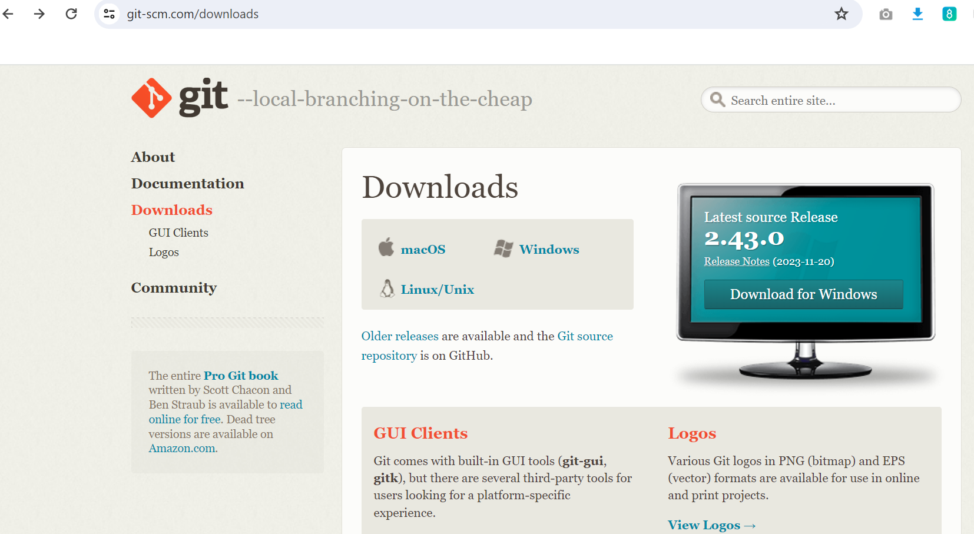
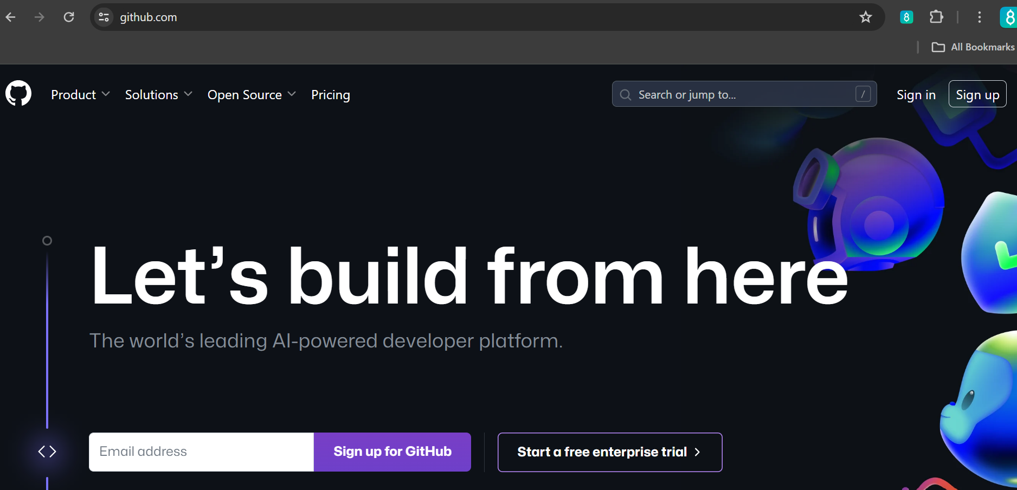
Download git from: https://git-scm.com/downloads
Create GitHub Account: https://github.com/

Slide 13
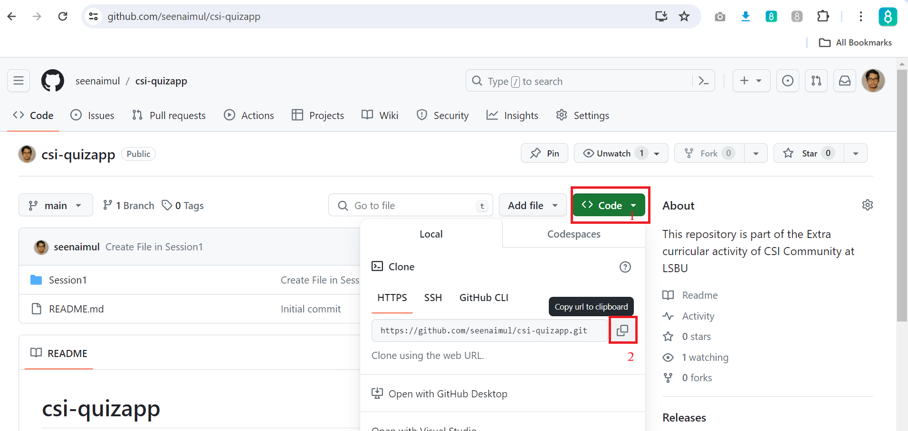
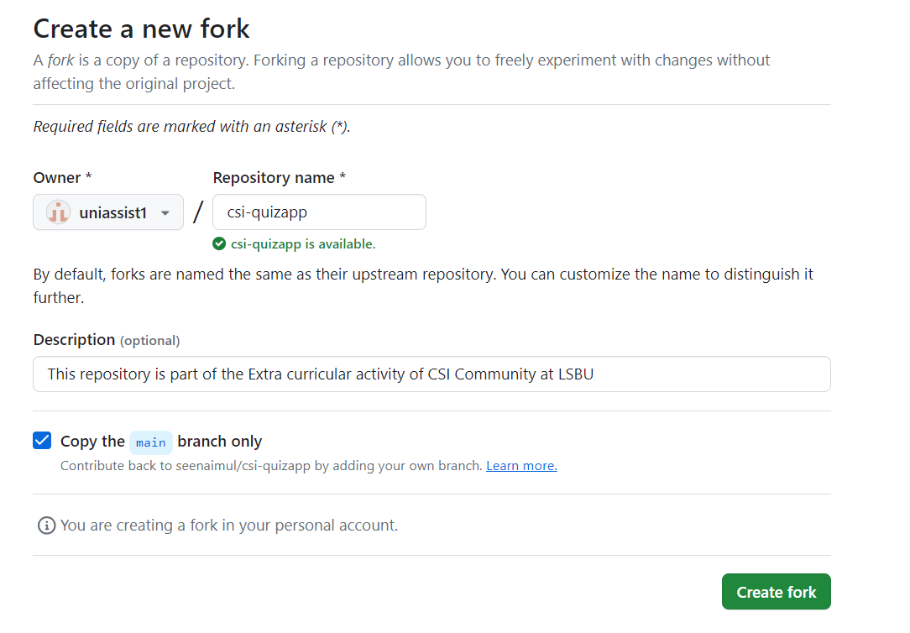
Copy the GitHub Repo in Your Account
Click on the 'Fork' of the Repo to create a copy in your account.
To clone from any public repository:
Go inside the repository and Click on the Green button 'Code'
Copy the HTTPS url of the repository
Once Git is installed, open any terminal/cmd prompt,
Go the location to save the project
Type the command 'git clone <url>'
For example: git clone https://github.com/seenaimul/csi-quizapp.git

Slide 14
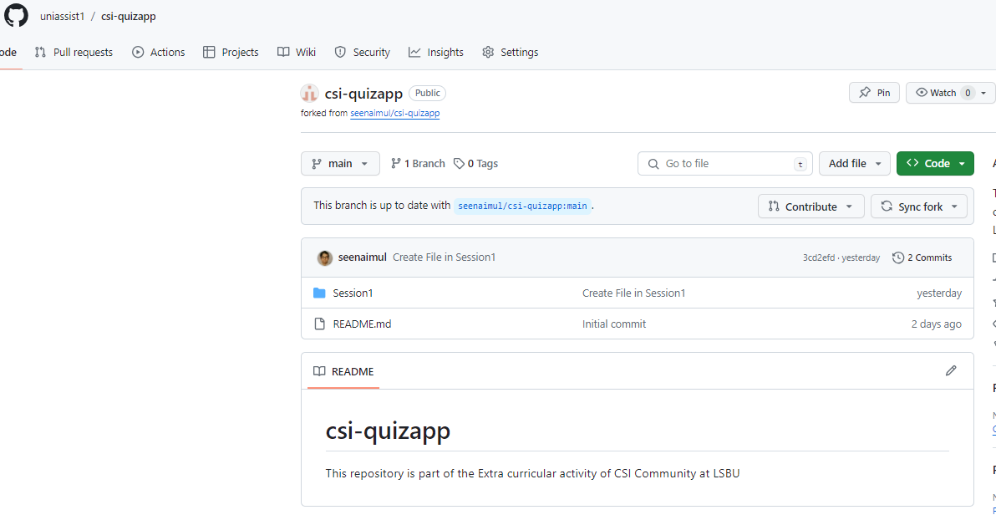
Copy the GitHub Repo in Your Account

Slide 15
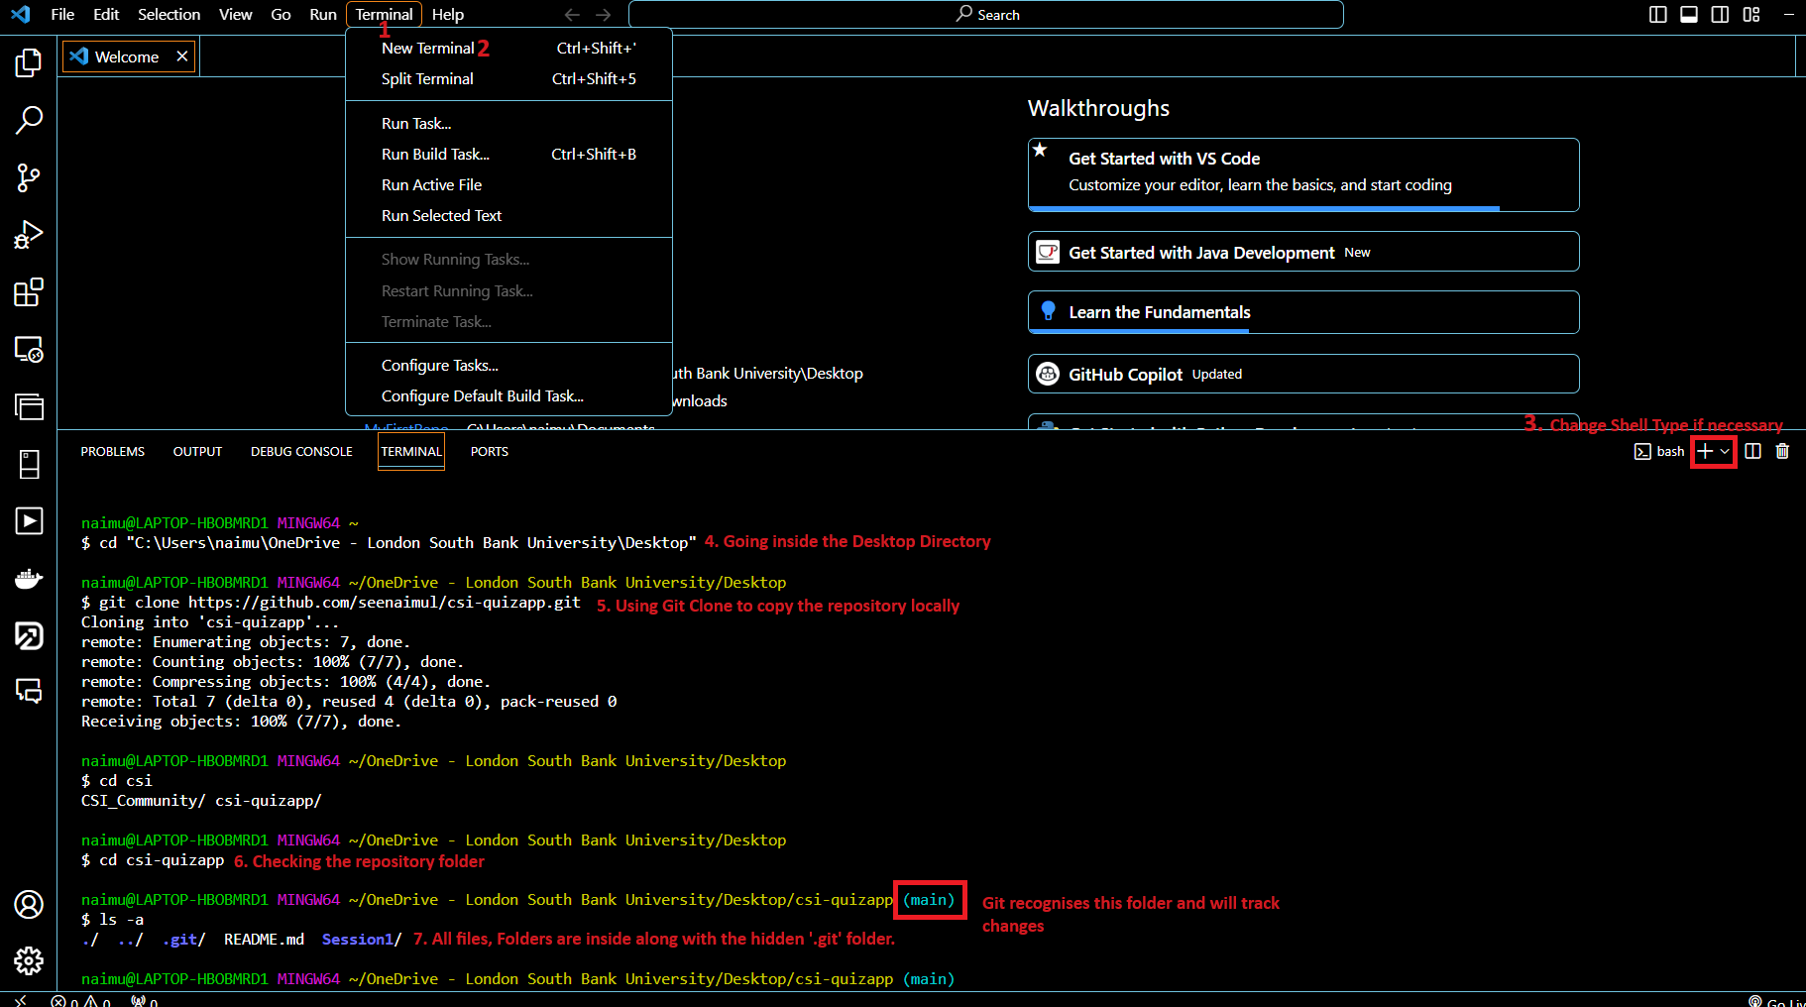
Clone the Repo from Your account

Slide 16
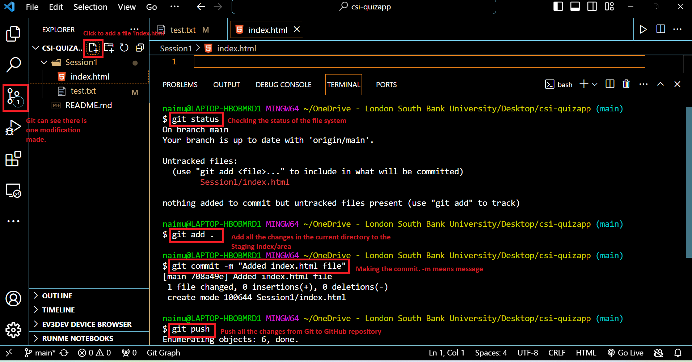
First Commit and Global Configurations

Slide 17
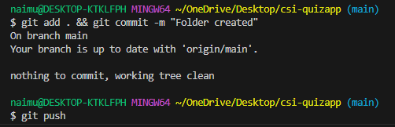
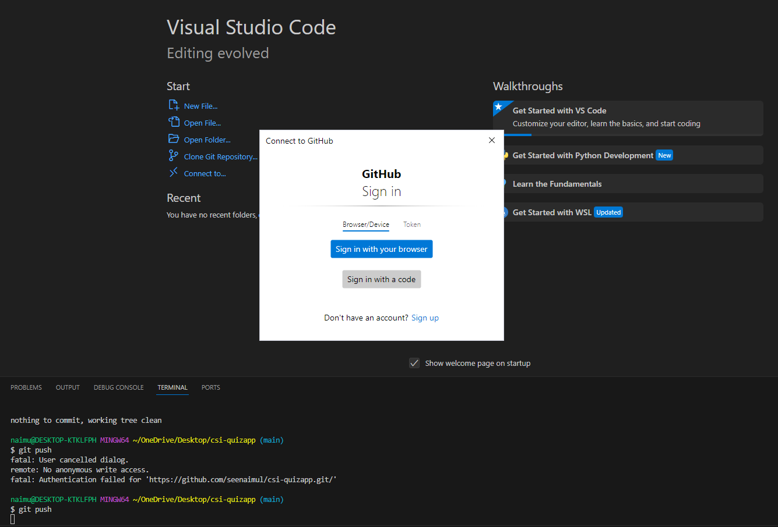
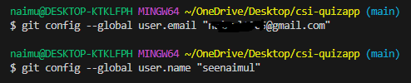
First Commit and Global Configurations
In the first ever Git push, GitHub will show the prompt for authentication.
When using for the first time, we should set these global configuration of user name and email.
'git config --list' will list all the configurations
Note: keeping the same username and email of the GitHub account is my personal choice.

Slide 18
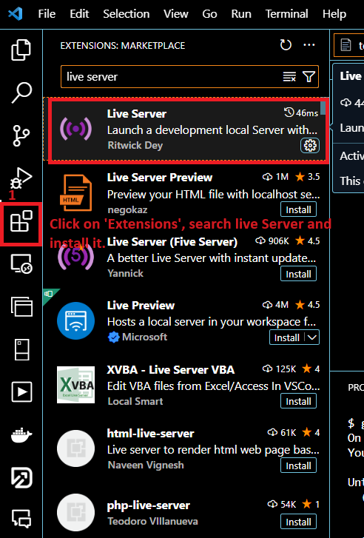
Installation of Live Server Extension

Slide 19
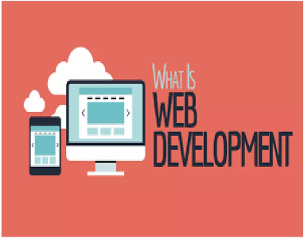
What is web development?
Web Development usually refers to developing the website for the Internet (World Wide Web) or for an Intranet (Private network).
Also known as Web Programming.
It is the creation of Dynamic Web Applications.
Examples of Web Applications are Social networking sites like Facebook or E-commerce sites like Amazon, Flipkart, etc.
There are two broad division of Web Development.
Front-end Development (also called Client-side Development)
Back-end Development (also called Server-side Development).

Slide 20
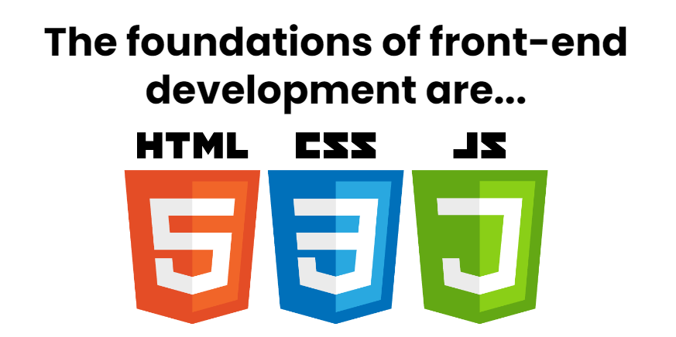
Front-End Development
Front end development refers to producing a web application so that a user can see and interact with them directly.
It is also known as Client-side development.
It focuses on the visual elements of a website that a user will interact with.
A front-end developer has one general responsibility: to ensure that website visitors can easily interact with the page. They do this through the combination of design, technology and programming to code a website's appearance, as well as taking care of debugging.
The common technologies we can use in front-end development are:
HTML
CSS
JAVASCRIPT

Slide 21
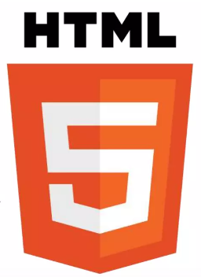
HTML (Hyper Text Markup Language)
Hypertext means that the document contains links that allow the reader to jump to other places in the document.
A Markup Language is a way that computers speak to each other to control how text is processed and presented.
It describes the structure of a web page and consists series of elements. It acts as a skeleton for a website since it is used to make the structure of a website.
Its elements tells browser how to display the content.
Its code is written in Notepad or any text editor but save it as .htm or .html extension.

Slide 22
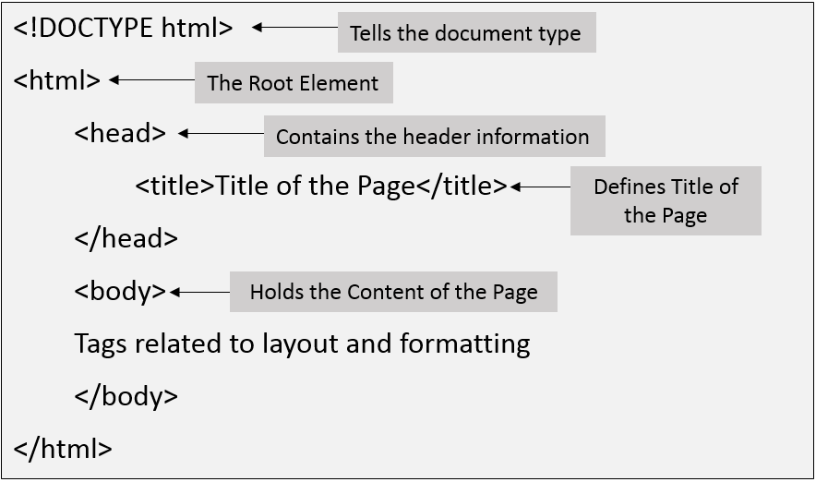
Structure of an HTML program

Slide 23
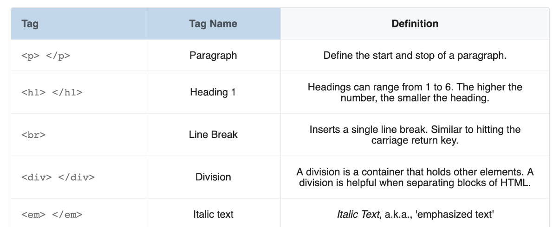
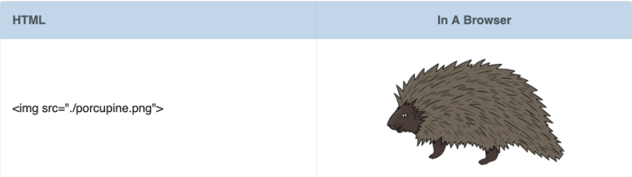
Common HTML Tags

Slide 24

CSS (Cascading Style Sheets)
Cascading Style Sheets (CSS) describes how HTML elements are to be displayed on screen. It is a simply designed language intended to simplify the process of making web pages presentable. It is used to style our website.
CSS saves a lot of work. It can control the layout of multiple web pages all at once.
It is also responsible for responsive layouts of a website.
It is also written in any text editor but save as .css extension.

Slide 25
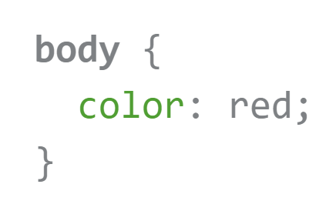
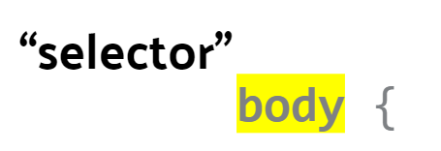
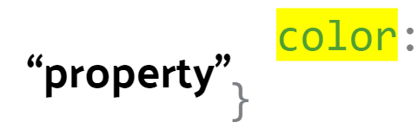
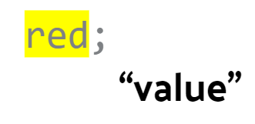
Let's look at the syntax
For example: text should be red.
The selector is body, which targets all text within the <body> element.
The property is color, specifying the text color.
The value assigned to the property is red.

Slide 26
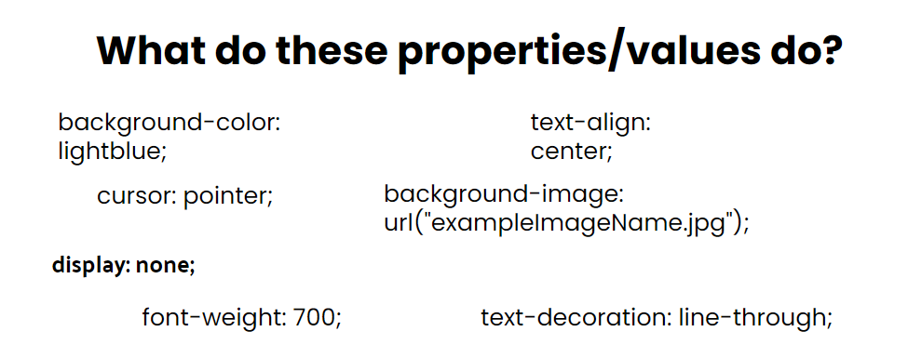
background-color: light-blue;: This property sets the background color of an element to light blue.
cursor: pointer;: When applied to an element, it changes the cursor to a pointer (usually a hand) when hovering over that element. This indicates that the element is clickable.
display: none;: This property hides an element from view. It effectively removes the element from the layout, making it invisible.
font-weight: 700;: This property makes the text within an element bold. The value 700 corresponds to the bold font weight.
text-align center;: When applied to a block-level element (like a <div>), it horizontally centers the text content within that element.
background-image: url("exampleImageName.jpg");: This property sets a background image for an element. The specified image file (in this case, “exampleImageName.jpg”) will be used as the background.
text-decoration: line-through;: When applied to text, it adds a strike-through line over the text. This is commonly used to indicate deleted or irrelevant content.

Slide 27

JavaScript
JavaScript is a scripting language used to provide a dynamic behavior to our website.
JavaScript is the Programming Language for the Web. JavaScript can update and change both HTML and CSS.
JavaScript ﻿ Allows web pages to be interactive Web pages can change as the user moves the mouse, clicks or types.
JavaScript is responsible for the Functioning of the website.
It is a scripting language that enables us to create dynamically updating content, control multimedia, animate images, and pretty much everything else.
It is also written in any text editor but add the .js extension.

Slide 28
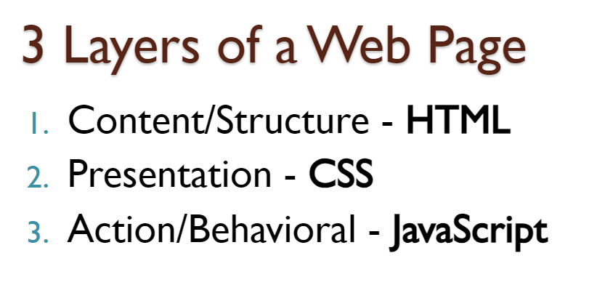
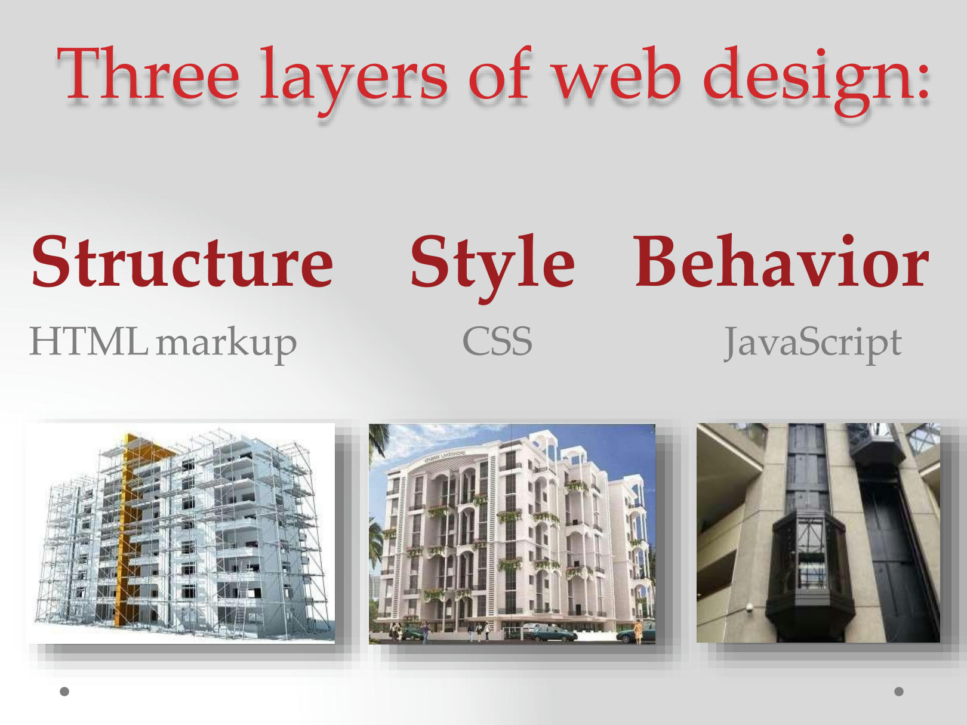
EXAMPLE:
Think of it like the skeleton of a building. Just as a building’s structure determines its layout and rooms, HTML organizes the content on a web page
Imagine the same building from before, but now it’s adorned with aesthetic enhancements—like paint, windows, and decorative elements. CSS adds visual appeal to the web page.
Picture an escalator in our building. It moves, responds to people stepping on it, and changes direction. Similarly, JavaScript adds functionality and responsiveness to your site.

Slide 29
Back-End Development
Back-end development controls what goes on behind the scenes of the web applications.
It is also known as server-side development.
Back-end usually consists of three parts:
■ A server
■ An Application
■ A Database
Users can't see how the backend works but this code is what communicates the database information to the browser.

Slide 30



Common Back-End development technologies
PHP﻿
PHP, which stands for “PHP: Hypertext Preprocessor”, is a widely-used, open-source scripting language. It operates on the server side, executing scripts to handle various tasks. Being free to download and use, PHP is a powerful tool for web development. It is embedded within HTML, allowing developers to manage dynamic content, databases, session tracking, and even build entire e-commerce sites.
Python
Python is a programming language that lets you work quickly and integrate systems more efficiently.
Node.js
Node.js is an open source and cross- platform runtime environment for executing JavaScript code outside a browser.

Slide 31
Who is a Web Developer?
A web developer is a programmer who specializes in the development of World Wide Web applications using a client-server model.
The applications typically use HTML, CSS and JavaScript in the client, PHP, C#, Python, Node.js or Java in the server, and http for communications between client and server.
There are 3 types of Web Developers -
■Front-End Developer,
■ Back-End Developer,
■Full Stack Developer.
Front-End Developer :-They are responsible for how a website looks. They create the site's layout and integrate graphics, applications (such as a retail checkout tool), and other content. They also write web design programs in a variety of computer languages, such as HTML or JavaScript.
Back-End Developer :- They are responsible for server-side web application logic and integration of the work front-end developers do.
Full-Stack Developer :- A Full-Stack Developer is someone familiar with both front and back-end development. They are generalists, adept at wearing both hats, and familiar with every layer of development. Obviously, employers want to hire Full-Stack Developers - according to an Indeed study, they are the fourth-most in-demand job in tech.

Slide 32
What Does a Web Developer Do?
Translating wireframe designs into working code: Web developers take visual wireframes or design mockups and turn them into functional websites by writing HTML, CSS, and JavaScript code.
Creating the architecture and content of a site: This involves structuring the website, organizing pages, creating navigation menus, and adding textual content.
Building in functionality and responsivity: Web developers implement interactive features, such as forms, buttons, sliders, and responsive layouts that adapt to different screen sizes.
Making a site go live: After development and testing, web developers deploy the site to a live server, making it accessible to users.
Updating and renovating sites: Maintenance is crucial. Developers continuously update content, fix bugs, and improve performance.
Troubleshooting, fixing bugs, and glitches: When issues arise, web developers diagnose problems and apply solutions to ensure smooth functionality.
Monitoring website traffic: Developers track user behavior, analyze metrics, and optimize the site for better performance.

Slide 33
Conclusion
In today's Web development, a good page design is essential. A bad design will lead to the loss of visitors and that can lead to a loss of business. In general, a good page layout must satisfy the basic elements of a good page design.
This includes color contrast, text organization, font selection, style of a page, page size, graphics used, and consistency. In order to create a well-designed page for a specific audience.

